Slide 1
Design Patterns: Design by Abstraction
CS 3331
Chapter 7

Slide 2
What Are Design Patterns?
Design patterns are:
Schematic descriptions of design solutions to recurring problems in software design, and
Reusable (i.e., generic), but don’t have to be implemented in the same way
That is, describe:
Design problems that occur repeatedly, and
Core solutions to those problems

Slide 3
Why Design Patterns?
To capture and document software design knowledge
=> helps designers acquire design expertise
To support reuse in design and boost confidence in software systems
To provide a common vocabulary for software designers to communicate their designs

Slide 4
Motivation
Modeling solar system
1..*
0..*
Sun
Planet
Moon
Q: How to make sure that there exists only one Sun object in the system?

Slide 5
In Java …
public class Sun {
private static Sun theInstance = new Sun();
private Sun() { /* … */ }
public static Sun getInstance() {
return theInstance;
}
// the rest of code …
}
Q1: Can a client create a Sun? “protected” constructor?
Q2: Can a client access the unique Sun? “public” final field?

Slide 6
Singleton Design Pattern
Intent
To ensure that a class has only one instance and provides a global access point to it
Applicability
Use the Singleton pattern when there must be exactly one instance of a class and it must be accessible to clients from a well-known access point
Benefits
Controlled access to the sole instance
Permits a variable number of instances

Slide 7
Gang of Four (GoF) Patterns*
Creational Structural Behavioral
Abstract Factory Adapter Chain of Responsibility
Builder Bridge Command
Factory Method Composite Interpreter
Prototype Decorator Iterator
Singleton Façade Mediator
Flyweight Memento
Proxy Observer
State
Strategy
Template Method
Visitor
*E. Gamma, R. Helm, R. Johnson, and J. Vlissides. Design Patterns, Elements of Reusable
Object-Oriented Software, Addison-Wesley, 1995.

Slide 8
Façade
Intent: want to simplify the use of an existing system. Need to define an interface that is a subset of the existing one.
Problem:
You only need a subset of a complex system or need to interact in a particular way.
The API for the subset is simpler than the API for the entire subsystem.
You may want to hide the original system, or you may want to use a subset of the system and add functionality.

Slide 9
Façade
Solution: The façade presents a new interface
Participants: presents a specialized interface to the client to make it easier to use
Consequences:
Simplifies the use of the subsystem.
Some functionality may not be available to the client.
Implementation:
Define a new class (or classes) that has the required interface.
Have this class use the existing system.

Slide 10
Façade Example
Huge database interface, but we only need a few of the functions.
Rather than everyone learning the database interface, create the interface you need, and build a façade.

Slide 11
Without Façade
ClientA
Database
ClientB
Model
Element

Slide 12
With Façade
ClientA
Database
ClientB
DBFacade
Model
Element

Slide 13
Adapter
Intent: match an existing object beyond your control to a particular interface.
Problem:
A system has the right data and behavior, but the wrong interface.
Use this when you have to make an existing class a subclass of a new class structure.

Slide 14
Adapter
Solution: Adapter provides a wrapper with the desired interface.
Participants: The adapter adapts the interface of an adaptee to match that of the adapter’s target. This allows the client to use the adaptee as if it were a type of target.
Consequences: the adapter pattern allows for pre-existing objects to fit into a new class structure with out being limited by their interfaces.

Slide 15
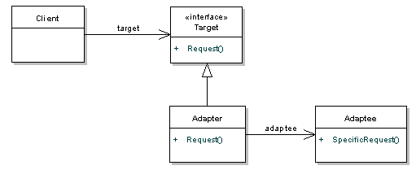
Adapter
Implementation: encapsulate an existing class in another class. The containing class matches the required interface.
When a class that you need to use doesn't meet the requirements of an interface

Slide 16
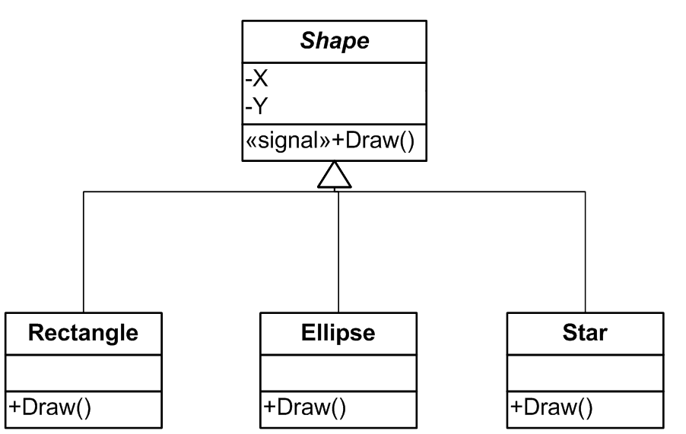
Adapter Example
Drawing program
Superclass called Shape
Subclasses
Rectangle
Ellipse
Star
Need to add circle
Have circle class implemented in a class called xcircle
But the circle I need must be of type Shape
Xcircle isn’t. The methods are named wrong.

Slide 17
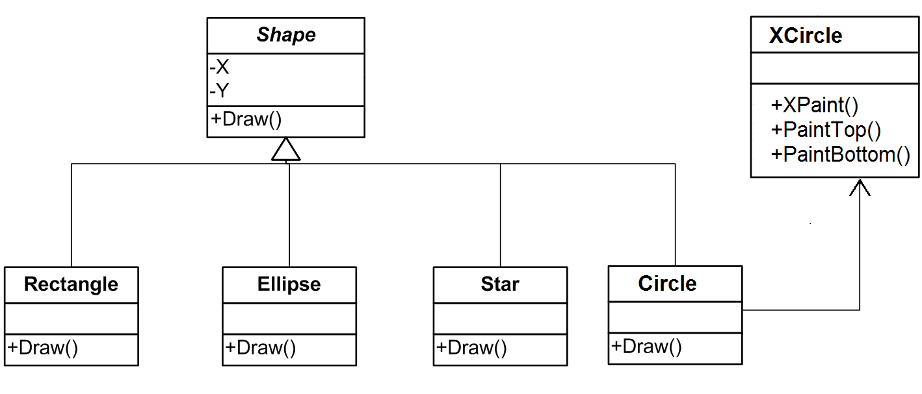
Adapter

Slide 18
Template Methods Design Pattern
Intent
To define a skeleton algorithm by deferring some steps to subclasses
To allow the subclasses to redefine certain steps
AbstractClass
templateMethod()
hookMethod1()
hookMethod2()
…
hookMethod1()
…
hookMethod2()
…
ConcreteClass
hookMethod1()
hookMethod2()

Slide 19
Template Methods (Cont.)
Terminology
Hook methods: placeholders for the behaviour to be implemented by subclasses
Template methods: methods containing hook methods
Hot spots: changeable behaviours of generic classes represented by hook methods
Frozen spots: fixed behaviours of generic classes represented by template methods

Slide 20
Strategy Design Pattern
Intent
To define a family of algorithms, encapsulate each one, and make them interchangeable
strategy
Context
contextMethod()
Strategy
alogorithm()
strategy.algorithm()
ConcreteStrategyA
algorithm()
ConcreteStrategyB
algorithm()

Slide 21
Abstract Coupling (Low Coupling)
Definition
Abstract coupling means a client access a service through an interface or an abstract class without knowing the actual concrete class that provide the service
Example
Strategy pattern
Iterator pattern
…
Question
Why abstract coupling?

Slide 22
Design Guideline
Program to an interface, not to an implementation!

Slide 23
Composite Design Pattern
To allow clients to treat both single components and collections of components identically
To define recursive data structures such as trees
uses
*
Client
Component
operation()
Leaf
operation()
Composite
operation()
add(Component)
remove(Component)

Slide 24
Iterator Pattern
Intent
To provide a way to access the elements of a collection sequentially
<<use>>
Iterator
hasNext()
next()
<<use>>
Collection
iterator(): Iterator
Client
ConcreteCollection
iterator(): Iterator
ConcreteIterator
hasNext()
next()
<<create>>
return new ConcreteIterator()

Slide 25
Side: Arrays vs. Collections
Code to implement the Iterator interface; use a collection.
public class Library {
private Book[] books;
private List<Book> books;
/** Returns an iterator to access all books of this library. */
public Iterator<Book> books() {
return books.iterator();
}
}

Slide 26
Factory Design Pattern
Intent
Create object without exposing the creation logic to the client and refer the new object using a common interface.
Client
Abstract Product
Factory
makeProduct()
create
ConcreteProuct

Slide 27
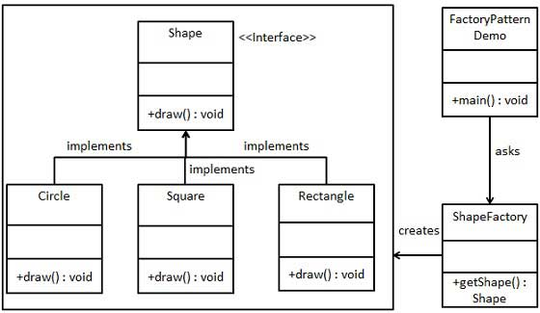
Factory Design Pattern
https://www.tutorialspoint.com/design_pattern/factory_pattern.htm

Slide 28
Abstract Factory Design Pattern
Intent
Produce families ofproducts
To decouple object creation from its use and to support different way of creating objects
To define an interface for creating objects but let subclasses decide which class to instantiate and how
Client
AbstractFactory
makeProduct()
Abstract Product
create
ConcreteProuct
ConcreteFactory
makeProduct()

Slide 29
Example
Complex numbers
ComplexFactory
makeComplext()
Complex
<<create>>
PolarFactory
makeComplex()
PolarComplex
RectangularFactory
makeComplex()
<<create>>
RectangularComplex

Slide 30
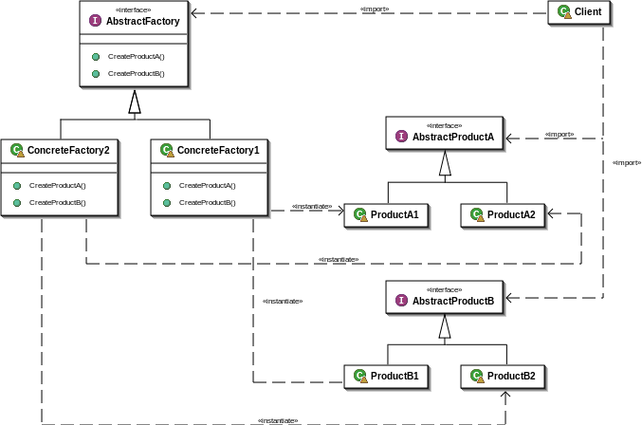
Abstract Factory Design Pattern
https://en.wikipedia.org/wiki/Abstract_factory_pattern

Slide 31
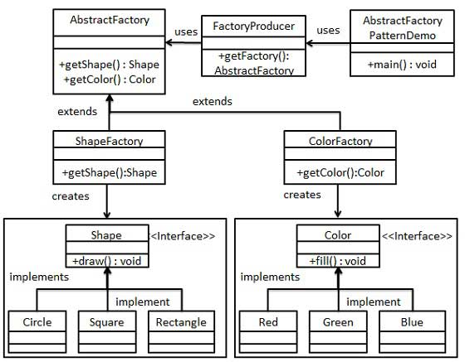
Example
Example

Slide 32
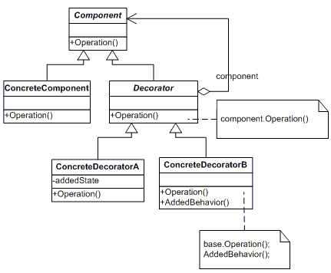
Decorator Pattern
To add additional responsibility or capability to an object dynamically

